Slide 1
LAB 2 INTRODUCTION TO VHDL
FACULTY OF ENGINEERING
CAIRO UNIVERSITY
CMPS301: COMPUTER ARCHITECTURE COURSE
EXERTED FROM DR. ADNAN SHAOUT- THE UNIVERSITY OF MICHIGAN-DEARBORN

Slide 2
What we learned last time
How to create Entity
How to implement Architecture
What different modeling could be used (Dataflow , behavioral, structural)
Code is Concurrent not sequential
“WHEN … ELSE” statement is concurrent only
Signals are wires
Different data types
How to reuse previously created entity (component instantiation a.k.a port mapping)
Intro to VHDL
Architecture course
2

Slide 3
Objectives
Review Conditional Concurrent statements
Others Keyword
Learn about Generic entities
Learn about For-Generate
Intro to VHDL
Architecture course
3

Slide 4
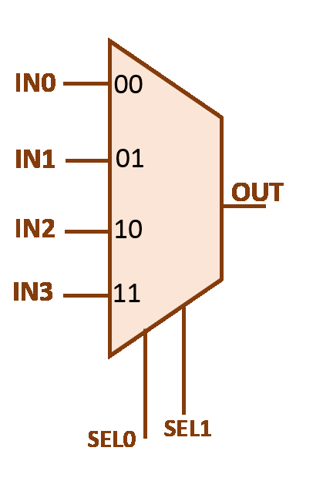
Remember Mux4x1
ENTITY mux IS
PORT( in0,in1,in2,in3: IN std_logic;
sel : IN std_logic_vector (1 DOWNTO 0);
out1: OUT std_logic);
END mux4;
Intro to VHDL
4
Architecture course

Slide 5
When … ELSE / With … Sel
ARCHITECTURE a_mux OF mux
BEGIN
out1 <= in0 WHEN sel = “00”
ELSE in1 WHEN sel = “01”
ELSE in2 WHEN sel =“10” ELSE in3;
END a_mux;
ARCHITECTURE b_mux OF mux
BEGIN
with sel select
out1 <=
in0 when "00",
in1 when "01",
in2 when "10",
in3 when "11";
END b_mux;
Intro to VHDL
Architecture course
5

Slide 6
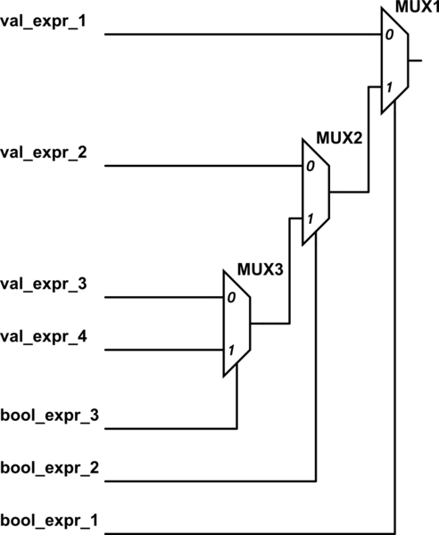
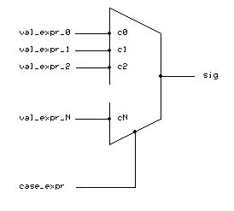
When … ELSE / With … Sel
Intro to VHDL
Architecture course
6

Slide 7
When … ELSE / With … Sel
What happens if we missed a case ?!
F <= a when Sel = “00”;
-- what is the Value of F if Sel is not 00 ?!!!!
Intro to VHDL
Architecture course
7

Slide 8
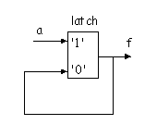
When … ELSE / With … Sel
What happens if we missed a case ?!
A latch will be formed to save previous value
F <= a when Sel = “00”;
-- what is the Value of F if Sel is not 00 ?!!!!
Intro to VHDL
Architecture course
8

Slide 9
Objectives
Review Conditional Concurrent statements
Others Keyword
Learn about Generic entities
Learn about For-Generate and if-Generate
Intro to VHDL
Architecture course
9

Slide 10
“OTHERS” Keyword
Use “OTHERS” Whenever you want to:
Set a bus to several zeros or several 1s but you don’t want to write it.
Example set F to 32 zero
F <= “00000000000000000000000000000000”;
F <= x“00000000”; -- hexdecimal
F<= (Others => ‘0’);
Intro to VHDL
Architecture course
10

Slide 11
“OTHERS” Keyword
Use “OTHERS” Whenever you want to:
Set a bus to several zeros or several 1s but you don’t want to write it.
Set a certain bit to value and others zero
Example
F <= “00000000000000000000000010000000”;
F <= x“00000080”; -- hexdecimal
F<= (7=>‘1’, Others => ‘0’);
Intro to VHDL
Architecture course
11

Slide 12
“OTHERS” Keyword
Use “OTHERS” Whenever you want to:
Set a bus to several zeros or several 1s but you don’t want to write it.
Set a certain bit to value and others zero
Generic Case in Switch Cases
Example
With S select
F <= a when “0010”,
b when others;
Intro to VHDL
Architecture course
12

Slide 13
Objectives
Review Conditional Concurrent statements
Others Keyword
Learn about Generic entities
Learn about For-Generate and if-Generate
Intro to VHDL
Architecture course
13

Slide 14
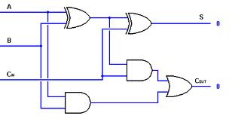
Let’s build a full adder ☺
Intro to VHDL
Architecture course
14

Slide 15
1bit-adder example
ENTITY my_adder IS -- single bit adder PORT( a,b,cin : IN std_logic; s,cout : OUT std_logic); END my_adder;
ARCHITECTURE a_my_adder OF my_adder IS
BEGIN s <= a XOR b XOR cin; cout <= (a AND b) or (cin AND (a XOR b));
END a_my_adder;
Intro to VHDL
Architecture course
15

Slide 16
Now how to build 4-bits full adder from 1-bit full adder?
Intro to VHDL
Architecture course
16

Slide 17
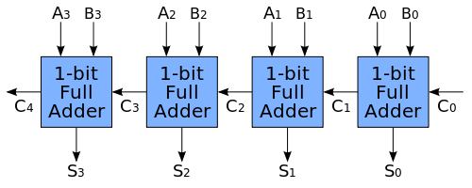
Carry-Propagate Adder
Intro to VHDL
Architecture course
17

Slide 18
4 Bit-full Adder
ENTITY my_nadder IS
PORT (a, b : IN std_logic_vector(3 DOWNTO 0) ;
cin : IN std_logic;
s : OUT std_logic_vector(3 DOWNTO 0);
cout : OUT std_logic);
END my_nadder;
Intro to VHDL
Architecture course
18

Slide 19
8 Bit-full Adder
ARCHITECTURE a_my_nadder OF my_nadder IS
COMPONENT my_adder IS
PORT( a,b,cin : IN std_logic; s,cout : OUT std_logic);
END COMPONENT;
SIGNAL temp : std_logic_vector(4 DOWNTO 0);
BEGIN
Temp(0) <= cin;
f0: my_adder PORT MAP(a(0),b(0),temp(0),s(0),temp(1));
f1: my_adder PORT MAP(a(1),b(1),temp(1),s(1),temp(2));
f2: my_adder PORT MAP(a(2),b(2), temp(2),s(2),temp(3));
f3: my_adder PORT MAP(a(3),b(3), temp(3),s(3),temp(4));
Cout <= temp(4);
END a_my_nadder;
Intro to VHDL
Architecture course
19

Slide 20
From Specific to Generic entities
ENTITY my_nadder IS
PORT (a, b : IN std_logic_vector(3 DOWNTO 0) ;
cin : IN std_logic;
s : OUT std_logic_vector(3 DOWNTO 0);
cout : OUT std_logic);
END my_nadder;
Now how can we change 4-bits full adder to generic n-bit full adder?
Intro to VHDL
Architecture course
20

Slide 21
From Specific to Generic entities
ENTITY my_nadder IS
PORT (a, b : IN std_logic_vector(n-1 DOWNTO 0) ;
cin : IN std_logic;
s : OUT std_logic_vector(n-1 DOWNTO 0);
cout : OUT std_logic);
END my_nadder;
Notice the use of ‘n’ here
But where did we define “n”
Intro to VHDL
Architecture course
21

Slide 22
From Specific to Generic entities
Integer another data type
8 is default value and could be override while instantiation
ENTITY my_nadder IS
GENERIC (n : integer := 8);
PORT (a, b : IN std_logic_vector(n-1 DOWNTO 0) ;
cin : IN std_logic;
s : OUT std_logic_vector(n-1 DOWNTO 0);
cout : OUT std_logic);
END my_nadder;
Add generic input
Notice the use of ‘n’ here
But where did we define “n”
Intro to VHDL
Architecture course
22

Slide 23
8 Bit-full Adder
ARCHITECTURE a_my_nadder OF my_nadder IS
COMPONENT my_adder IS
PORT( a,b,cin : IN std_logic; s,cout : OUT std_logic);
END COMPONENT;
SIGNAL temp : std_logic_vector(4 DOWNTO 0);
BEGIN
temp(0) <= cin;
f0: my_adder PORT MAP(a(0),b(0),temp(0),s(0),temp(1));
f1: my_adder PORT MAP(a(1),b(1),temp(1),s(1),temp(2));
f2: my_adder PORT MAP(a(2),b(2), temp(2),s(2),temp(3));
f3: my_adder PORT MAP(a(3),b(3), temp(3),s(3),temp(4));
Cout <= temp(4);
END a_my_nadder;
Intro to VHDL
Architecture course
23

Slide 24
8 Bit-full Adder
ARCHITECTURE a_my_nadder OF my_nadder IS
COMPONENT my_adder IS
PORT( a,b,cin : IN std_logic; s,cout : OUT std_logic);
END COMPONENT;
SIGNAL temp : std_logic_vector(n DOWNTO 0);
BEGIN
temp(0) <= cin;
f0: my_adder PORT MAP(a(0),b(0),temp(0),s(0),temp(1));
f1: my_adder PORT MAP(a(1),b(1),temp(1),s(1),temp(2));
f2: my_adder PORT MAP(a(2),b(2), temp(2),s(2),temp(3));
f3: my_adder PORT MAP(a(3),b(3), temp(3),s(3),temp(4));
Cout <= temp(4);
END a_my_nadder;
Change size of signal
Intro to VHDL
Architecture course
24

Slide 25
8 Bit-full Adder
ARCHITECTURE a_my_nadder OF my_nadder IS
COMPONENT my_adder IS
PORT( a,b,cin : IN std_logic; s,cout : OUT std_logic);
END COMPONENT;
SIGNAL temp : std_logic_vector(n DOWNTO 0);
BEGIN
temp(0) <= cin;
loop1: FOR i IN 0 TO n-1 GENERATE
fx: my_adder PORT MAP(a(i),b(i),temp(i),s(i),temp(i+1));
END GENERATE;
Cout <= temp(n);
END a_my_nadder;
Change size of signal
i →is not visible outside the for generate
Intro to VHDL
Architecture course
25

Slide 26
For….Generate
We use it when we want to generate more than one component of the same type
loop1: FOR i IN 0 TO n-1 GENERATE
fx: my_adder PORT MAP(a(i),b(i),temp(i-1),s(i),temp(i));
END GENERATE;
The (for …generate) is not a Software Sequential loop .. It is like writing this line n times and they execute concurrently. Generates N hardware
i →is not visible outside the for generate
i →is not visible outside the for generate
Intro to VHDL
Architecture course
26

Slide 27
Generic ….cont.
So after I made my entity generic when I instantiate I do the following
u0: my_nadder GENERIC MAP (16) PORT MAP (……)
I indicate here the value of the generic data
Generic could be more than one parameter like generic (n,m : integer;)
Even could be with different type
Intro to VHDL
Architecture course
27

Slide 28
Generic ….cont.
In simulation
vsim my_nadder –g<genericName>=<value>
Example
vsim my_nadder –gn=8
Intro to VHDL
Architecture course
28

Slide 29
Common Errors
During Coding:
Mix the use of bit & std_logic
Using port map inside a condition
Size of Input Vector not Equal Size of Output Vector
During Simulation:
Simulating without compiling last changes
Not forcing all input ports at initialization
Force values on output port/signal
Intro to VHDL
Architecture course
29

Slide 30
Summary
Review on (When .. Else / With…Sel)
Use of “OTHERS” keyword
Make Generic Entities & use them
Use “for … Generate”
Intro to VHDL
Architecture course
30

